Slide 1
RAILWAY MANAGEMENT SYSTEM
Group 10

Slide 2
GROUP MEMBERS
Doan Thuan An
Nguyen Thuy Linh
Vu Yen Linh
Nguyen Thi Quynh Anh
Trinh Tuan Tu
Nguyen Hai Anh

Slide 3
CONTENTS
01
02
03
PROBLEM STATEMENT
ER DIAGRAM
SQL DEMONSTRATION

Slide 4
Problem statement
01
Railway booking system for VNR

Slide 5
Entities

Slide 6
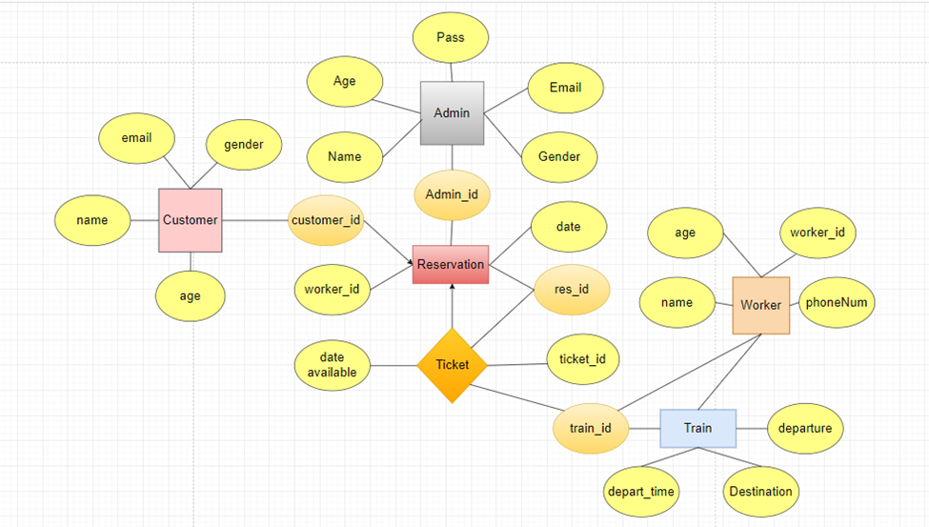

Slide 7

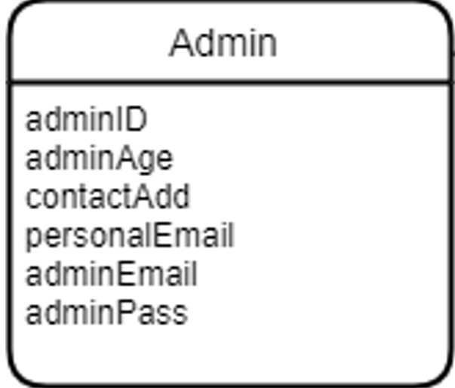
Administrators

Slide 8
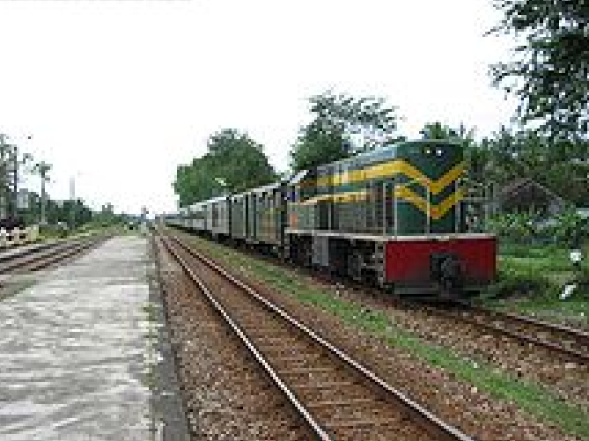
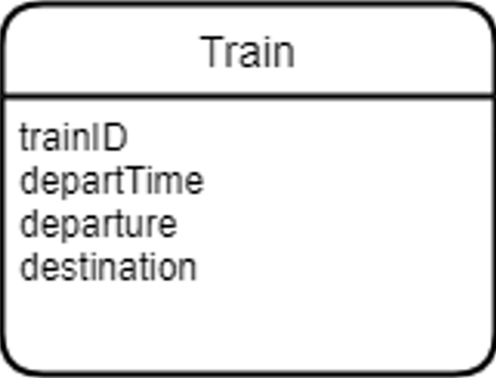
Train

Slide 9
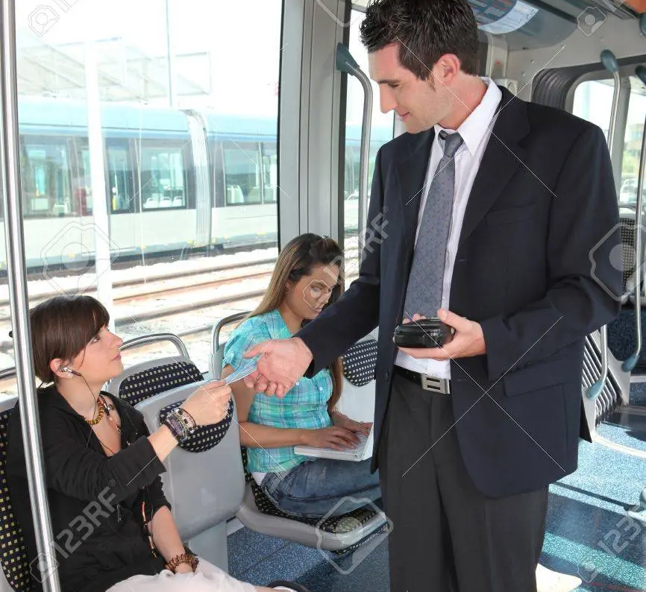
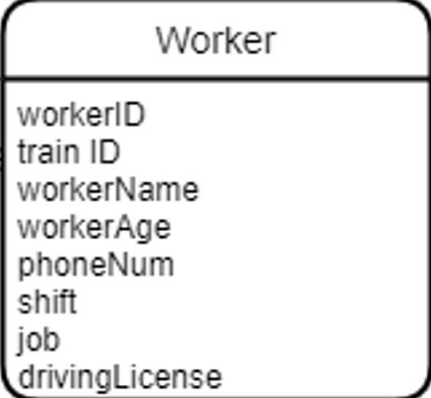

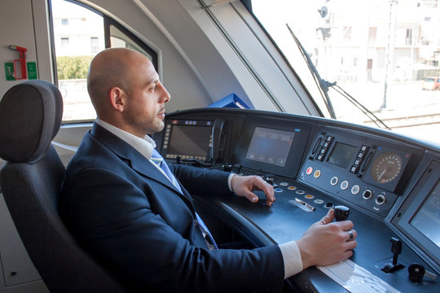
Workers

Slide 10
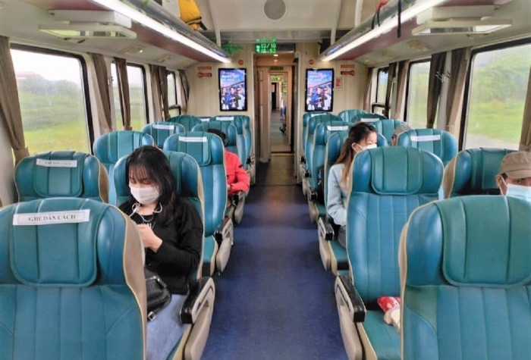
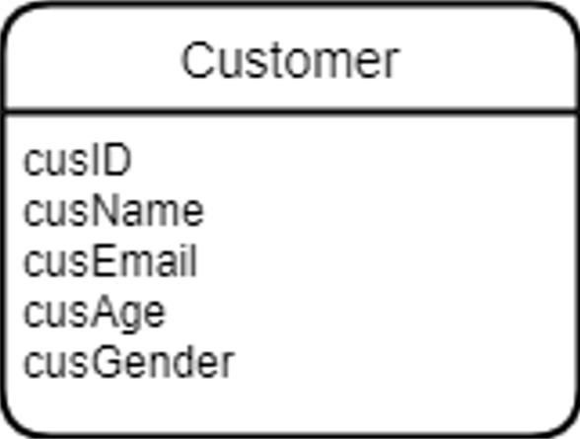
Customers

Slide 11

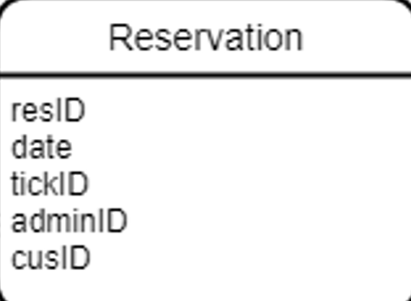
Reservation

Slide 12
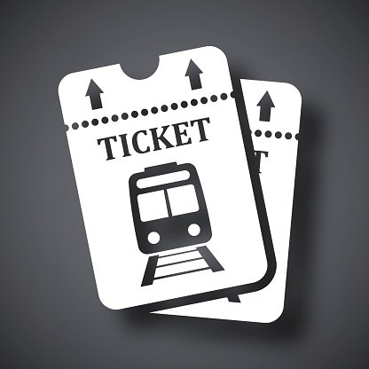
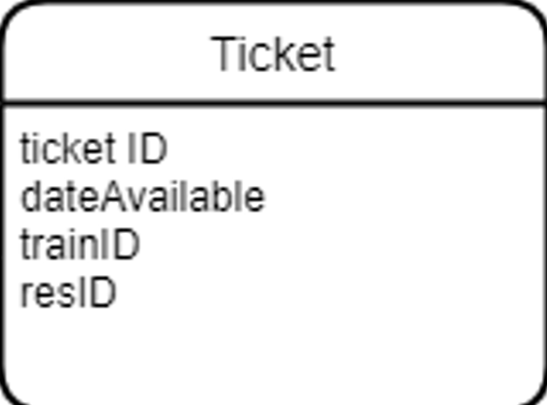
Ticket

Slide 13
MODELLING
02
Entity-Relationship Diagram

Slide 14
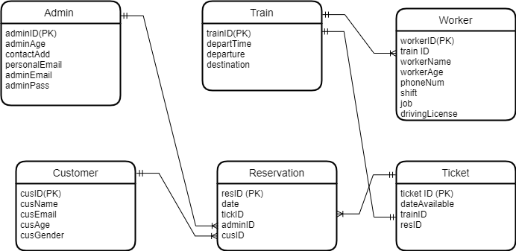
Entity-Relationship Diagram

Slide 15
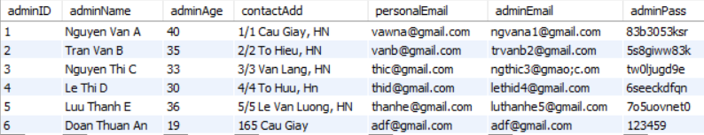
Table example: Administrator

Slide 16
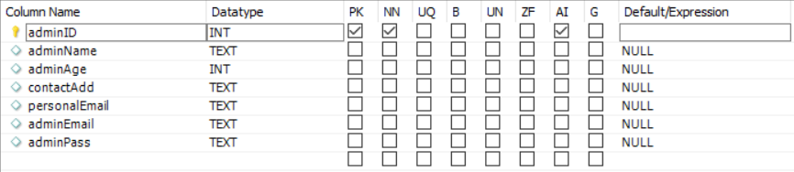
Tables info

Slide 17
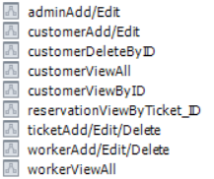
Stored Procedures

Slide 18
Demo
03
Railway booking system for VNR

